Slide 1

DREAM DESTINATIONS GETAWAYS
Presented by Tiny Coders
Team Members
Erika Valle-Baird
Domeniko Kondra
Mohammed Khoshkoiyazdi
Madison Bilko
Collin Cavanaugh

Slide 2

INTRODUCTION
Dream Destination Getaways is an LLC providing users with the vacation planning ensuring the lowest possible prices and enabling them to travel to destinations previously believed to be outside their price ranges. Dream Destination Getaway’s website will be developed via a complete software project management plan for creating and maintaining a website for the lowest travel fares. The destination does not have to be known, however both depart and return dates have to be specified per user. Once a flight has been added to the user’s shopping cart, the user will have the ability to decide if a hotel and rental car are necessary, and have the ability to add such items in their shopping cart.

Slide 3
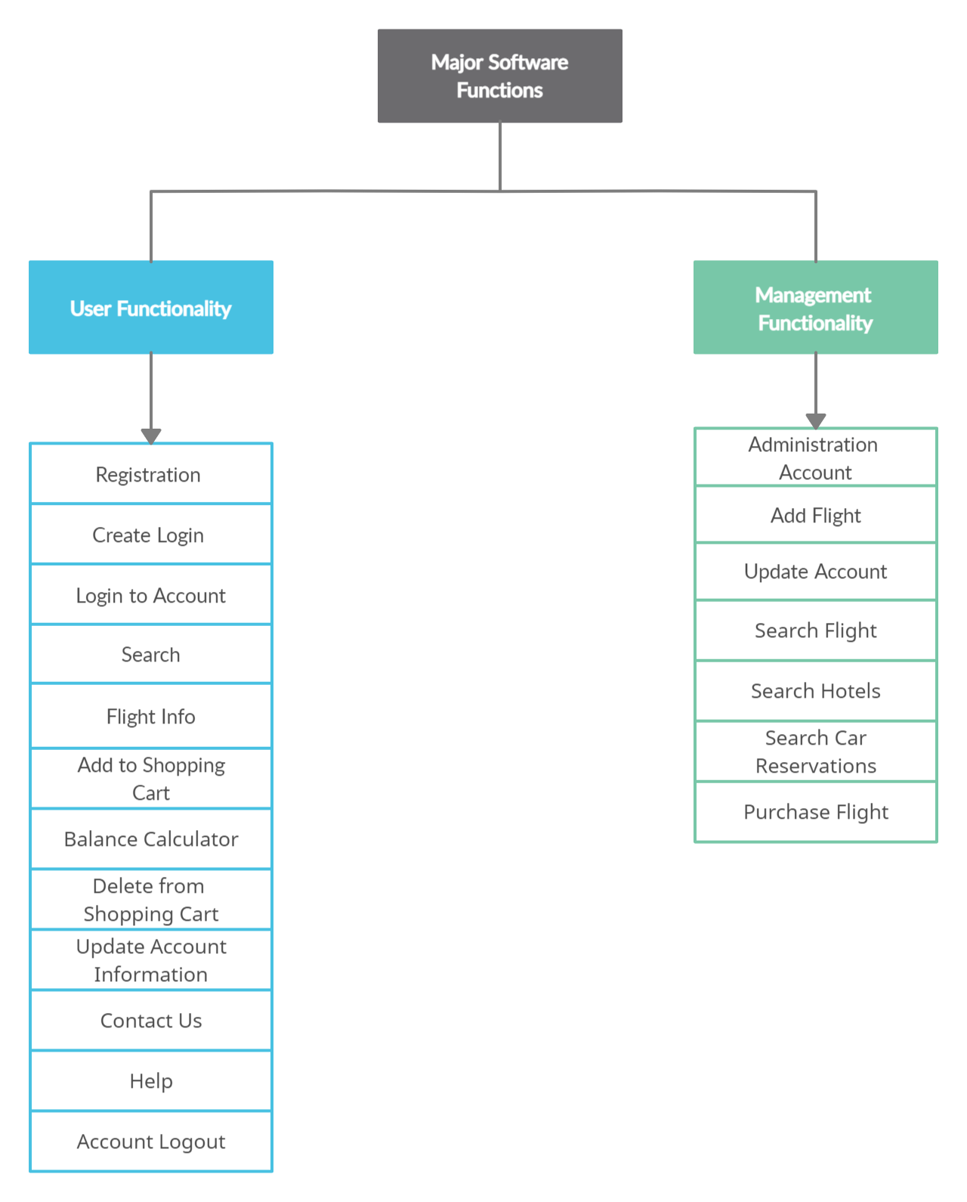

Slide 4
Domain
External Inputs (EI)
External Outputs
(EO)
External Inquiries
(EQ)
Internal
logical files
(ILF)
External
Interface Files
(EIF)
Login to Account
Account Registration
Contact Us
Shopping Cart Checkout
Generate a Receipt
None
Item Information
Logout of Account
Help
Update Account Information
Search Results
Delete Item from Shopping Cart
View Previous Transactions
Shopping Cart
Checkout
Add an Item
View Past Transactions
Shopping Cart
Add Package to Shopping Cart
Generate Receipt
Past Transactions
Update an Item
Balance Calculator
Add Item to Shopping Cart
Account Information
Flight Search

Slide 5
COCOMO
Cost Driver Variables | Effort | Rating
RELY | 1.00 | Nominal
DATA | 1.00 | Nominal
CPLX | 0.85 | Low
TIME | 1.00 | Nominal
STOR | 1.00 | Nominal
VIRT | 0.87 | Low
TURN | 0.85 | Low
ACAP | 1.00 | Nominal
AEXP | 1.25 | Low
PCAP | 1.00 | Nominal
VEXP | 0.95 | High
LEXP | 0.90 | High
MODP | 0.90 | High
TOOL | 1.00 | Nominal
SCED | 1.00 | Nominal
Dream Destination Getaways has an average complexity, due to the backgrounds of our programmers and small team size, along with a stable environment we are using semidetached intermediate COCOMO.
Effort =(3.0 * (KDSI)^1.12) * EAX
where EAX = Effort Adjustment Factor
KDSI= number of delivered source instructions in thousands.
Time =2.5 * (Effort)^0.35,
where Effort = Effort calculated above

Slide 6

COCOMO
Effort = (3.0 * (KDSI)^1.12) * EAX
= (3.0 * (11.2)^1.12) * 0.67
= 30.08 PM
Time = 2.5 * (E)^0.35
= 2.5 * (30.08)^0.35
= 8.23 Months
= 8 Months

Slide 7
Function | FP | Weighting Factor | LOC/FP | Total LOC
Account Registration | EI, ILF | 4 + 4 | 64 | 512
Update Account Information | EI | 4 | 64 | 256
Add an Item | EI, ILF | 4 + 4 | 64 | 512
Update Item | EI | 4 | 64 | 256
Balance Calculator | EO | 8 | 64 | 512
Contact Us | EO | 8 | 64 | 512
Help | EO | 8 | 64 | 512
Account Login | EQ | 9 | 64 | 576
Account Logout | EQ | 9 | 64 | 576
Add to Shopping Cart | EO , EQ, ILF | 8 + 4 + 9 | 64 | 1344
Delete from Shopping Cart | EQ, ILF | 8 + 4 | 64 | 768
Search | EO, EQ | 8 + 9 | 64 | 1088
Checkout | EO , EQ | 8 + 9 | 64 | 1088
Delete Item | EQ | 9 | 64 | 576
Generate a Receipt | EO, ILF | 8 + 4 | 64 | 768
View Previous Transactions | EO, EQ, ILF | 8 + 9 + 4 | 64 | 1344
LOC TOTAL |  |  |  | 11200
LOC-BASED ESTIMATION
WEIGHTING FACTORS:
External Inputs: 4
External Outputs: 8
External Inquires: 9
Internal Logical Files: 4
Total LOC = 11200

Slide 8
LOC CONTINUED
TOTAL OF LINES OF CODE = 11200 LOC
KDSI = 11.2 KLOC
PRODUCTIVITY
= Total Lines of Code/Effort
= 11200 LOC / 30.08 PM
= 372.34 LOC/PM
AVERAGE STAFFING
= Effort / Time
= 30.08 PM / 8 Months
= 3.76 Persons
= 4 Persons

Slide 9
LOC CONTINUED
AVERAGE BURDENED LABOR RATE:
Using our staff estimate of an average of 4 staff members,
assuming they all work full-time,
with a pay rate of $20 an hour.
AVERAGE BURDENED LABOR RATE:
= 4 Staff Members * (40 hours/week) * (4 weeks/month) * ($20/hour)
= $12800/month

Slide 10
LOC CONTINUED
COST PER LOC
= Burdened Labor Rate / Productivity
= $12800/372.34
= $34.38/LOC
TOTAL COST
= Cost/LOC * Total LOC
= $34.38 Cost/LOC * 11200 LOC
= $385,056

Slide 11
FUNCTION POINTS
Factor | Value
Backup required | 5
Data communication | 5
Distributed processing | 4
Optimal performance | 3
Heavily used operating system | 3
Online data security | 5
Multiple screens | 2
Online master file update | 4
Complex inputs, Queries, Outputs | 3
Complex internal processing | 3
Reusable code | 2
Conversion/ installation in design | 1
Multiple user sites | 1
Ease of use | 5
Value Adjustment factor | 44
Information Domain Value | Count | Weighting Factor | Total
External Input (EI) | 4 | 5 | 20
External Output (EO) | 8 | 6 | 48
External Inquires (EI) | 9 | 5 | 45
Internal Logical Files (ILF) | 4 | 8 | 32
External Interface Files (EIF) | 0 | 0 | 0
Count Total |  |  | 145

Slide 12
FUNCTION POINTS CON’T
Using C++ language for the LOC/FP Estimate:
LOC/FP = 64
FP = CT * (0.65 + (0.01 x ΣFi))
Count Total (CT) = unadjusted function points from table
ΣFi= total score from questionnaire 14 complexity
adjustment factors with values 0 to 5
Count Total (CT) = 145
ΣFi = 44

Slide 13
FUNCTION POINTS CONTINUED
FP = CT * (0.65 + 0.01 x ΣFi)
= 145 * (0.65 + (0.01 * 44))
= 158.05 FP
Average productivity
= FP / Effort
= 158.05 FP/30.08 PM
= 5.25 FP/PM
Burdened labor rate = $12800/month
Cost per FP is approximately
= Burdened Labor Rate/Average productivity
= $12800/5.25
= $2438.1/FP

Slide 14
FUNCTION POINTS CONTINUED
TOTAL ESTIMATED PROJECT COST
= Cost/FP * FP
= $2,438.1 Cost/FP * 158.05 FP
= $385,341.70
THE TOTAL ESTIMATED EFFORT
= FP/Productivity
= 158.05 FP / 5.25 FP/PM
= 30.10 Person-Months
THE TOTAL ESTIMATED DURATION
= Effort / (4 weeks/month)
= 30.10 PM / (4 weeks/month)
= 7.53 Months

Slide 15
FINAL ESTIMATED COST:
= (Total LOC Cost + Total FP Cost) / 2
= ($385,056 + $385,341.7) / 2
= $385,198.85
RECONCILED ESTIMATE
FINAL ESTIMATED EFFORT:
= (LOC Effort + FP Effort) / 2
= (30.08 + 30.10) / 2
= 30.09 PM
FINAL ESTIMATED DURATION:
= (LOC Duration + FP Duration) / 2
= (8 + 7.53) / 2
= 7.77 Months

Slide 16
RISK MANAGEMENT
Priority = (11 – Likelihood) * (11 – Impact) * Cost
Risk Title | Likelihood | Impact | Cost | Priority | Mitigation Plan | Assigned | Target Date
Personnel Shortfalls | 6 | 8 | 8 | 120 | Regularly scheduled meetings with clear expectations voiced. | EB | Cont.
Developing the wrong software functions | 3 | 5 | 6 | 288 | Subject system to regular tests. | DK | Cont.
Developing the wrong user interface | 3 | 5 | 6 | 288 | Subject system to regular tests. | MK | Cont.
Customer Data Security | 5 | 9 | 9 | 108 | Frequent stress tests. | MB | Cont.
Technology will not meet exceptions | 5 | 3 | 4 | 192 | Monitor database activity. | CC | Cont.
Poor Comments in code | 2 | 2 | 3 | 189 | Try to resolve by using standard commenting procedures. | DK | Cont.
Deviation from software engineering standards | 3 | 4 | 4 | 224 | Ensure software development methods are agreed upon in advance. | EB | Cont.

Slide 17
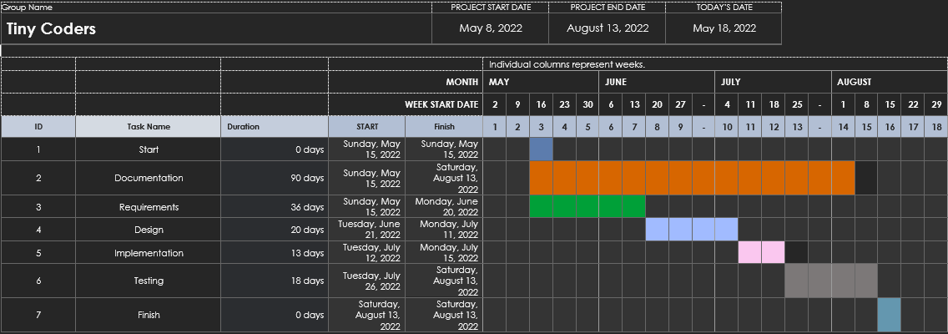
PROJECT SCHEDULE

Slide 18
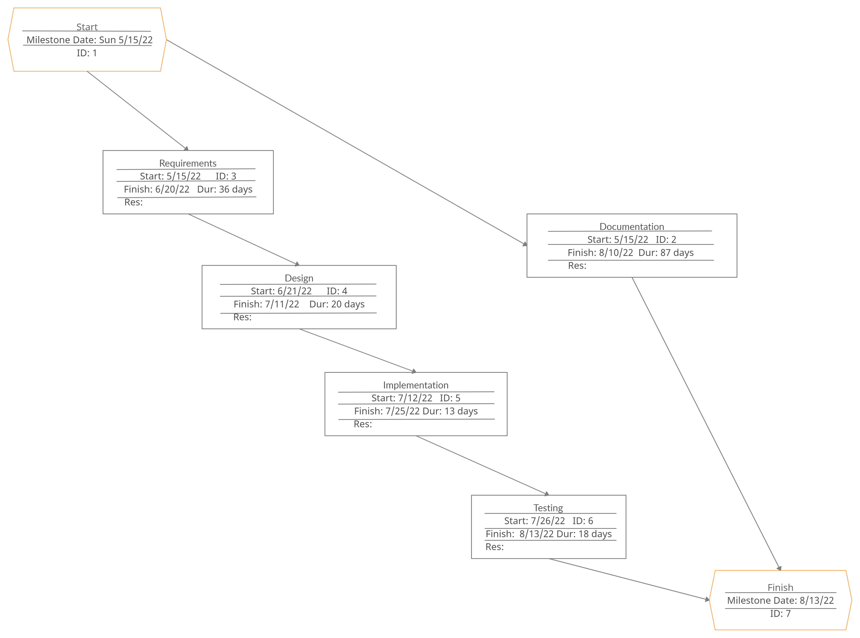
TASK NETWORK

Slide 19
STAFF ORGANIZATION
TEAM STRUCTURES:
Our group will be using and maintaining a democratic team approach to developing our project. This team structure was chosen to enable our team to be productive, reduce the strain of one individual, and ensure equal responsibility.
ROLE AND DESCRIPTION | Name
Project Manager | Erika Valle-Baird, Madison Bilko
Project Scheduling | Mohammed Khoshkhoiyazdi, Collin Cavanaugh
Project Estimation | Erika Valle-Baird, Mohammed Khoshkhoiyazdi, Domeniko Kodra, Madison Bilko, Collin Cavanaugh
Risk Mgmt. | Erika Valle-Baird, Mohammed Khoshkhoiyazdi, Domeniko Kodra, Madison Bilko, Collin Cavanaugh

